Slide 1


TECHNICAL COMMUNICATION (KAS – 301)
UNIT – 2
TOPIC : Résumés
Presented by
Dr. RENUKA
Assistant professor
Applied Science and Humanities
IMS Engineering College, Ghaziabad

Slide 2
COVER LETTER
A covering letter serves the purpose of creating the necessary background to any submission.
It also indicates the origin of the submission by specifying the authorization for a study or project.
Any document in the form of a proposal, a questionnaire, a resume, or a report should be accompanied with a covering letter.
The receiver decides if he /she should read the accompanied document right then or later based on the cover letter.
The covering letter offers a first impression to the reader, and must be written with care.

Slide 3
Résumés
Résumés are technical as well as marketing documents that present the candidate's past and present performance to the prospective employers so that they can assess his/her future potential.
In fact, a prospective employer forms his or her first impression of the candidate from the résumé. Employers usually have more they can handle, and hence, they naturally look for ways of narrowing down to a manageable number.
An effective résumé will put the candidate into the shortlist.
Hence, a job application letter should always have two essential parts : a cover letter and a
résumé.

Slide 4
Résumé, Biodata, and Curriculum Vitae
Although the terms résumé, biodata, and curriculum vitae (CV) are synonymously used ,they differ from each other in certain aspects.
In French, résumé means summary. It includes the individual's education, past employment, and skills for the new position. The résumé include the following features:
Summary of educational qualification
Written in points
Objective and formal in approach
Employment history
Written in third person
Professional affiliation
Name and address of the applicant
Personal information such as date of birth, marital status, nationality, and gender are generally not included in in a resume
It can also be modified according skill sets required by a particular job. For instance, if engineering students wish to apply the post of a software executive post, they may highlight their skill sets in software.

Slide 5
A biodata is a shortened form of biographical data, and has now become an obsolete term. In this format, the emphasis is on personal details such as date of birth, nationality, marital status, gender and address. The applicant's hobbies may also find a place in a biodata. These details are followed by the educational qualification, work experience, and skills for the job.
A curriculum vitae contains all the elements of a résumé but it is more detailed in terms of the academic credentials. It is generally used for a position in a research organization or when the candidate applies for a research fellowship. A CV contains a detailed account of all the papers published, papers presented at the conferences, and research projects carried out.
On the other hand, a résumé may just mention the number of conferences attended/ number of papers published/a brief summary of the projects carried out.
We can say that a CV is more knowledge-oriented whereas a résumé is more skill-oriented.

Slide 6
Résumé Design and structure
A résumé should present a brief summary of the candidate's personal details followed by details such as career objectives, educational qualifications, professional and technical skills, and extracurricular activities and achievements.
It should not be very long, as the applicant will get the opportunity to present detailed information if shortlisted for the interview
Appearance and elements
Personal Information
Career / professional objective
Education/ academic preparation
Work experience/ professional skills.
Activities, achievements special interests, aptitudes, memberships
References
.

Slide 7
1. Appearance and elements
A résumé, like every important business document, should be impeccable. Any mistakes or sloppiness here could raise doubts in an employer's mind rewarding the person's capability. The purpose of the résumé is to get called for an interview. It must be well-organized so that vital information is readily accessible. A résumé should reflect the professional image that we want to create. It should be:
Neat and error-free with no whiteouts or hand .
Legible and well- spaced
Printed on good quality paper of A-4 size.
Reproduced clearly on a high-quality printer or copy machine
The general notion is that the more the achievement in life, the lengthier the résumé. However, the ideal length for résumé is around one page, and it should never exceed two pages.

Slide 8
2. Personal Information
The first thing an employer needs to know is who you are and where you can be reached. So include your name, address, phone numbers, email address, and website under this heading.
Career specialists recommend that you proceed 'carefully and cautiously' and set up boundaries to keep your job search out of your current employment. You may not want to list your current business phone or business email. A personal email address and home or cell phone is preferable.
One might set up a separate email account especially for seeking employment. Ensure that it sounds professional and does not sound frivolous. An email ID like volcano 2000@ hotmail.com may be okay for personal use, but a prospective employer might not like it. A permanent postal address should be provided, indicating how long the address will be valid (i.e. ‘ until June 31’)

Slide 9
3. Career/professional objective
This element is optional.
While stating the objective, make it effective by being as specific as possible about the requirement or aspiration.
For example,
Entry-level position in design and development of microprocessor circuitry.
eventual advancement to position as project leader or technical manager.

Slide 10
4. Education /academic preparation
While applying for a job when one is about to graduate, educational qualification & experience are the highest selling points. Employers are usually interested in learning about the candidate's academic training, especially education and training since high school, degree earned, major and minor fields of study, courses or projects done, and also the experience gained during graduation.
Begin with the most recent education and work backward. If the information helpful and if space permits, we may consider listing notable courses taken. If the grade - point average of the candidate is impressive, it should be included.
Finally, note any honour earned. If the individual has received awards for other accomplishments, all achieving can be listed in a separate section entitled Awards and Honours’.

Slide 11
5. Work experience/ professional skills
A prospective employer would always be interested in a candidate's past work experience.
When describing work experience, list jobs in chronological order, with the present or last one first.
Include any part-time or summer internships or projects done, even if unrelated to the career objectives.
It demonstrates the person's ability to get and hold a job - an important qualification in itself.
Each entry in this heading includes the name and location of the organization where one has worked or completed an assignment, the job title/designation, the duration of work also a brief summary of the work.
There is no need to use complete sentences; phrases will suffice.
Be sure to use concrete language, including technical terminology, to describe the work experience.

Slide 12
6. Activities, achievements, special interests, aptitudes, memberships
Most employers want to know about special abilities that will make an individual a more valuable employee. These include professional courses undertaken, community service/ volunteer activities, languages known (written and spoken communication, knowledge of handling special equipment, relevant hobbies, and so on.
Activities can be grouped into categories such as College Activities, Community or Social Services, and Seminars and Workshops.
Mention awards or honours received. Give details regarding the nature of the award, the activity for which the award was received, date or month and year of receiving, and also the authority from whom the award was received.
If we belong to any organizations in our field, those can be listed under Membership .

Slide 13
7. References
This section should always be the last one in a résumé. For space and privacy considerations, one may simply include the phrase "References available upon request' and supply the names only when and if asked for, as employers rarely investigate references until the candidate is under serious consideration.
If references are impressive enough to merit listing, follow these basic guidelines:
Choose only the three or four people who combine the best elements of familiarity with the work and a credible position.
A reference from a celebrity who barely knows you is from an unknown person who has worked closely with you.
In any case, do get permission beforehand from the people listed as references.

Slide 14
Types of Résumés
There are three types of résumés:
Chronological
Functional
Hybrid (also called combination résumés)

Slide 15
Chronological résumé
The chronological résumé emphasizes education and work experience and is most effective experience clearly relates to the job we are seeking.
Within the categories Education, Work Experience, and Related Experience (if there is such a section), list entries in reverse order, beginning with the most recent experience.
Under each position listed under Work Experience, describe responsibilities handled and accomplishments, emphasizing on relevant experience with the skill set required for the job that one seeks.
In case of recent graduates, listing education first makes sense.
The chronological approach is the most common way of organizing the information in a résumé, and it is preferred by most employers.

Slide 16
Functional résumé
functional résumé features the skills that the candidate has got (organizer, researcher, manager, etc.) It provides examples of the most significant experiences that demonstrate these abilities.
This résumé emphasizes individual fields of competence and is hence used by applicants who are just entering the job market, who want to redirect their careers, or who have little continuous career-related experience.
In a nutshell, it demonstrates the applicant's ability to handle the position they are applying for.
While drafting a functional résumé, follow the Skills category immediately with a chronological Work History and a scaled-down Education section that lists only institutions, degrees, and dates.
Either of the latter two categories may come first, depending on whether most of the skills and experience were gained in college or on the job.

Slide 17
Hybrid combination
A combination résumé includes the best features of the chronological and functional résumés.
This type is not popular or not commonly used as it tends to be very long and also may turn out to be repetitive in nature.
Whatever the format, strong résumés possess the same qualities:
They focus on the employer's needs.
They are concise.
They are honest.

Slide 18
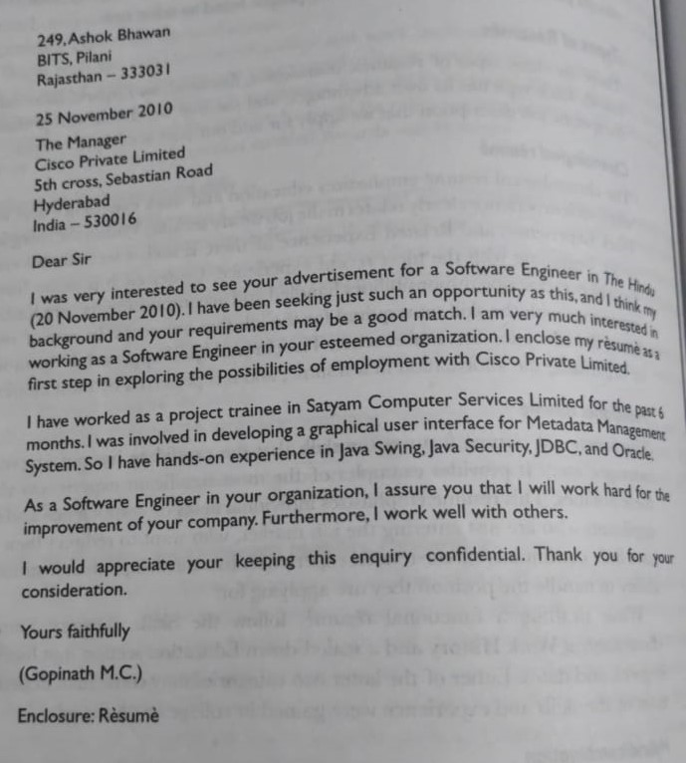
COVER LETTER (Sample)

Slide 19
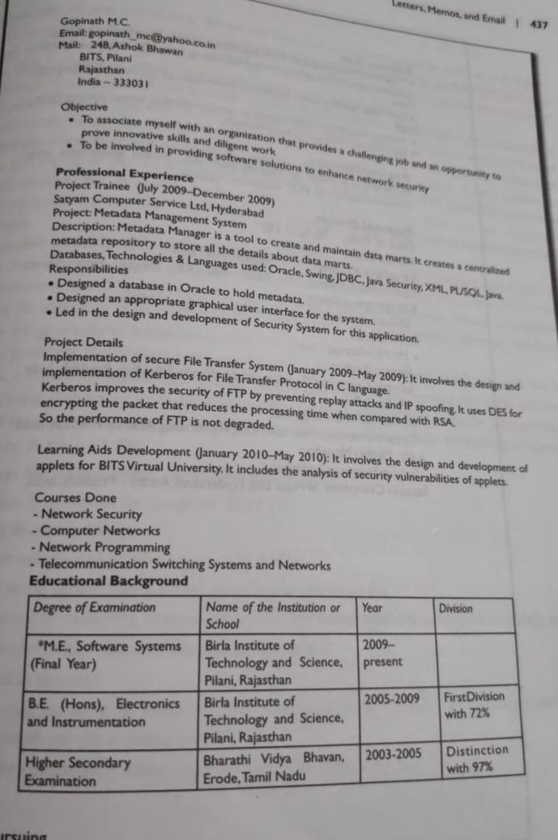
RESUME (sample)

Slide 20
